Slide 1
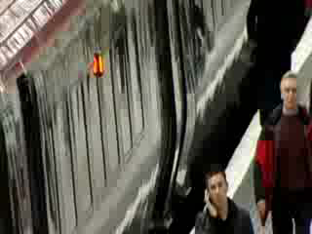
Something Different

Slide 2
Hypnosis
What is it?

Slide 3
What Comes To Mind?
This?

Slide 4
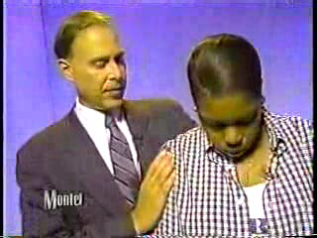

Slide 5
Or Maybe This?

Slide 6



Slide 7
Or Hopefully...
This?

Slide 8


Slide 9
Preconceptions
It’s important to ask the question: What comes to our minds when we hear the word “HYPNOSIS”
Do we see:
  Las Vegas shows with people walking like chickens and quacking like ducks?
  T.V. shows with audience participants acting supposedly against their will?
  Movies with Dracula, Mesmer or even Svengali?
We can assume that if we don’t see hypnosis this way, the majority of our patients will. For this reason it is important to clarify what hypnosis is and what it can and cannot do.

Slide 10
Definition of Hypnosis
1876, "inducement of sleep," coined by the British surgeon James Braid, (as an alternative to hypnotism) from Gk. hypnos "sleep" ( somnolence) + -osis "condition."
An artificially induced altered state of consciousness, characterized by heightened suggestibility and receptivity to direction.
A combination of cognitive-behavioral therapy, visualization and meditation

Slide 11
Belief Systems and Expectations
Whether we’re doctors or patients, we all respond to the concept or word “hypnosis” in a:
  sometimes predictable,
  sometimes skeptical,
  maybe superstitious,
  and more often than not, overly anxious way.

Slide 12
Our individual reactions to hypnosis are determined by the belief systems and ensuing expectations with which we have developed. If we have been exposed to hypnosis in the context of the first two videos, we will expect to experience it that way. We can even say the same for dentistry: The more we believe and expect through our own painful experiences (or through the painful experiences of others) to experience pain, the more likely we will be to experience pain and trauma when we are in the dentist’s chair.

Slide 13
These belief systems and expectations result from a process of classical learning theory of association and identification.
Right from the beginning, we need to normalize hypnosis and help the patient realize that we won’t be able to make them do anything they wouldn’t ordinarily want to do.
It can’t grow limbs. It can’t take away your own free will and choice.

Slide 14
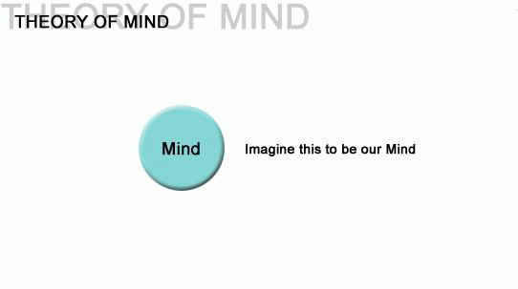
Functional Paradigm of Hypnosis: How does it work?
We accept the idea of the tri-partite mind as espoused by Plato, Freud, Maclean, etc.

Slide 15
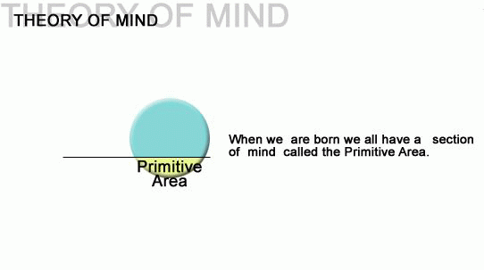
Functional Paradigm of Hypnosis: How does it work?

Slide 16
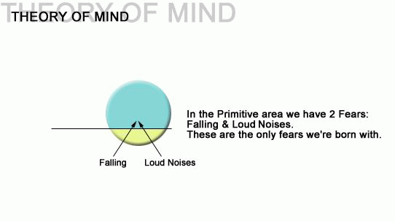
Functional Paradigm of Hypnosis: How does it work?
We expand these two fears into adulthood to be : fears of rejection and losing control

Slide 17
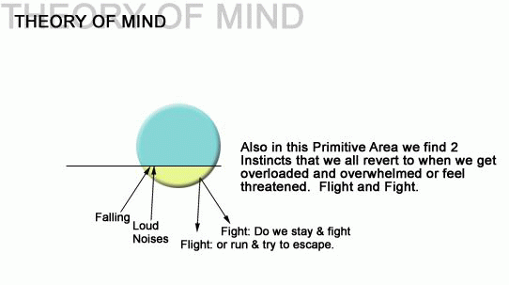
Functional Paradigm of Hypnosis: How does it work?
These two instincts, as we will see later, can be used and are used to drive the individual to escape into a hypnotic state.

Slide 18
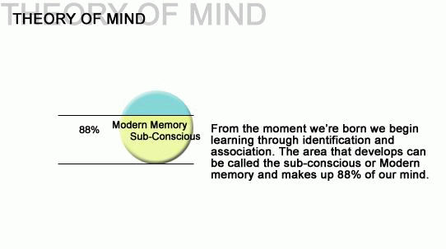
Functional Paradigm of Hypnosis: How does it work?
It’s crucial that we accept the concept of the sub-conscious mind. Whether real or not, we effect change on a level that is unknown to the Beta Brain or 14-30 Hz wave length.

Slide 19
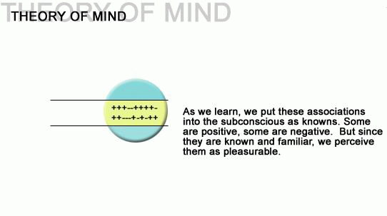
Functional Paradigm of Hypnosis: How does it work?
These knowns make up our extensive memory system that can be altered.

Slide 20
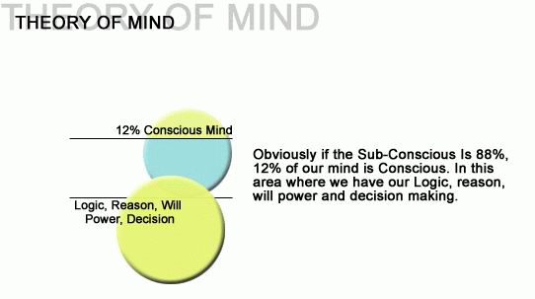
It’s here in the conscious mind or waking state, that we try to alter behavior but as we’ll see, it’s in the sub-conscious where that behavior is actually altered or maintained. Although in our conscious mind we can reason through logic that, for example, we need to stop smoking because it’s injurious to our health, it’s our subconscious that knows it brings us pleasure to smoke and that motivates us to continue the behavior.
Motivation will always win out over logic, reason and will-power.

Slide 21
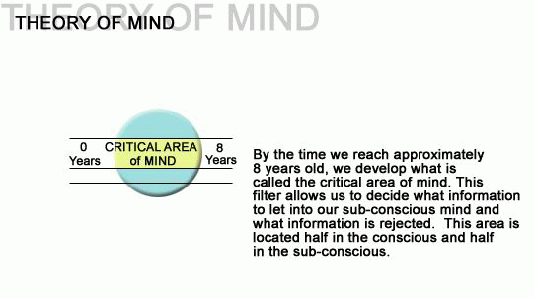
As can be seen here, this correlates with the findings of children being more hypnotizable and more impressionable. A child of 4 and 5 has a very weak critical mind. It’s this critical area that eventually will make up our defense system. It’s this critical area that also determines whether and to what extent we will be susceptible to negative and/or positive experiences and suggestions in life.

Slide 22
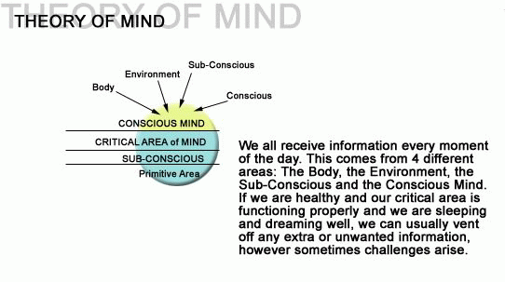
Functional Paradigm of Hypnosis: How does it work?
The way we receive and process this external and internal information is what we call SUGGESTIBILITY.

Slide 23
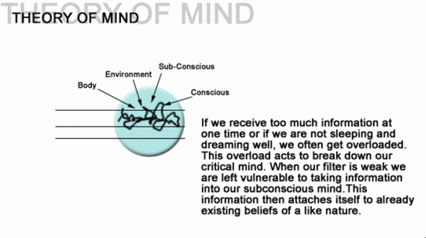
Here we can see what happens if we don’t maintain physical and mental health and how we become subject to negative information and its effects.
Often we find subjects that are already in hypnosis due to not:
Dreaming
Sleeping
Eating Healthy
Staying Healthy

Slide 24
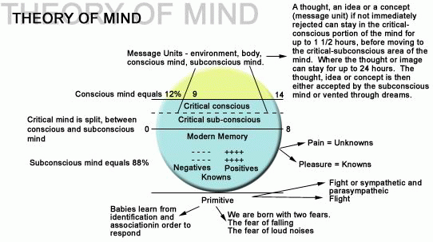
Functional Paradigm of Hypnosis: How does it work?
Here we have an overview of the Hypnosis Paradigm

Slide 25
Functional Paradigm of Hypnosis: How does it work?
The Insidious Catch-22
Its in the primitive area where our anxieties reside. The more we allow ourselves to function from this area, the more that anxiety will drive us to stay in the area.

Slide 26
Suggestibility
Definition-How we take in information..
Information includes:
Smells
Tastes
Colors
Textures
Emotions
Thoughts
Actions

Slide 27
Suggestibility and Hypnotizability
Up until the early 1950’s it was thought that only 25% of everyone was hypnotizable. With the work of Orne, Erickson, Kappas, a theory of suggestibility was revised wherein it was understood that everyone had a different way of being hypnotized according to how they took in information. Once suggestibility was understood, the practitioner could then design his/her suggestions to match the individual and therefore facilitate the acceptance of the specific suggestion.

Slide 28
The Following are the 3 different types of Suggestibility
Literal
Inferential
Somnambulistic

Slide 29
Literal Type
Example: mother insists that child must come in from playing outside and eat dinner. After going back and forth on this issue, the mother stands her ground and doesn’t give in. The child then realizes that what a person says is what they mean. They will, from then on, receive information directly and without re-interpretation. Example: As an adult, if told they look beautiful today, they will usually say: “Thank You” and that would be that. This type of suggestibility is healthy and less neurotic. This individual is more receptive to hypnosis and receiving suggestions.

Slide 30
Inferential Type
Example: mother insists that child must come in from playing outside and eat dinner. After going back and forth on this issue, the mother eventually gives in. The child learns that what a person says is not what they mean and will from then on take information in through the back door. They will always re-interpret whatever is presented to them. As an adult if told they look beautiful today, they will usually think, what does she mean by that? What is she trying to say? Was there something wrong with me last time. Obviously, this type can be much more neurotic and very problematical. This individual is usually more skeptical and harder to put under.

Slide 31
Somnambulistic (Sleepwalker)
This individual is suggestible in both ways and therefore highly hypnotizable. This person generally made up that initial 25% of hypnotizables and makes up those that we see on stage in Vegas. The issue here is that the persons defenses are too diffused and they need to increase their ability to protect themselves from unwanted suggestions. We often find people that work with coaches (actors, athletes and musicians) to be highly somnambulistic having learned to be responsive to suggestion for a lone period of time.

Slide 32
Determining Suggestibility and Hypnotizability
By asking certain questions and observing behavior, we can determine suggestibility type.
  Your left arm is light as a feather while your right arm is holding a heavy bowling ball…check reaction
  Did you or have you ever walked in your sleep.
  Have you ever awakened from a dream and felt that you were paralyzed or could not move or speak
  Mind..\Videos\mind-motivations.exe Motivations
  Spiral Key
  Stanford Hypnotic Susceptibility Scale
  Harvard Group Scale of Hypnotic Susceptibility-A
  www. Lifefirst.com suggestibility test
  Spiegel- Hypnotic Induction Profile-eye-roll

Slide 33
Aside from the Paradigm, other explanations for how hypnosis works
Other explanations have taken several main forms:
  Parasympathetic Nervous System Activation
  Brain-Wave Patterns
  Complex Interaction of both Brain Hemispheres
  Placebo Effect (expectancy theory)
  Dissociated control theory (Bowers 1992)
  Social-Cognitive Theory (kirsch & Lynn 1997)
  Neodissociation Theory (Hilgard 1986)
  Neurophysiological theory (Gruzellier 1998)
  Integrative cognitive theory (Oakley & Brown 2004)
  Cold control theory (Dienes & Perner 2007)
  Dissociated experience theory (Kihlstrom (1985)
  Ego-psychological theory (Fromm 1992)

Slide 34
How and When Is It Experienced?
We all experience hypnosis every moment of the day.
Driving and missing our stop - we were in hypnosis
Watching a movie and losing track of time - we were in hypnosis.
Playing video games, watching T.V., eating, exercising, day - dreaming, etc.
Being stressed at work or home, being ill, medications, drugs and alcohol.
Every time we go into our thoughts we are in hypnosis and every time we come out of thoughts we come out of hypnosis.
It’s like breathing

Slide 35
The Object of the Game
Lewis R. Wolberg, M.D. stated: Hypnosis is an intensely meaningful interpersonal experience for the patient, into which he may project strivings, fears and neurotic demands such as are operative whenever he involves himself in a close relationship.
Rollo May stated: “Its like falling in love”
Allow the patient to enter a state between waking and sleep (alpha state) where their defenses are lower and they can readily accept the suggestions that will alter their learned associations. Allow the critical core to diminish in strength through relaxation and trust.
It’s this rapport and therapeutic alliance that allows for work to be done whether in talk therapy or in hypnotherapy. It’s this transference and trust that motivates the patient to lower their defenses and allows overriding more desirable suggestions to replace negative ones.

Slide 36
What to Expect and How to Proceed
Induction Techniques (Progressive relaxation,Arm-raise,etc) Deepening Processes (staircase,elevator,etc) and Suggestion techniques (reciprocal inhibition, associations, visualizations, etc.)
As the patient enters the office either for hypnosis itself or for a dental procedure, the level of anxiety being experienced at the time will be high. As this anxiety increases, the desire to escape into hypnosis will also increase.
Initially, the work will be to establish trust and rapport
  Confidence
  Warmth
  Empathy
The patient will be educated about hypnosis
  Natural
  Like breathing
  Will not do anything they wouldn’t normally do

Slide 37
What to Expect and How to Proceed (Cont.)
As almost every hypnosis session begins, the patient will be eased into a mild trance through either a progressive or passive muscle relaxation exercise beginning with a focus on deep breathing exercises (diaphragmatic breathing).
  Focus on a spot on the ceiling
  Start taking deep breaths where with each inhale they feel the positive strength and comfort entering into their body while with each exhale they’re releasing and letting go of all fears, doubts, tensions and the past
  They begin to visualize a beam of light in any color they wish entering their body from the tips of their toes moving up to the head with each body-part at a time from the largest muscles and bones to the smallest cells and molecules until the jaw drops and they begin to feel very heavy.
  The patient is counted down from 5-0 at which time the therapist says: “DEEP SLEEP” etc.

Slide 38
What to Expect and How to Proceed (Cont.)
Now the patient’s defenses will be lowered and he/she will allow the therapist or practitioner to deepen the trance through various methods and then they can use specific techniques to replace negative painful associations with more enjoyable associations.
Reciprocal Inhibition
Visualization
Systematic Desensitization
Cognitive Restructuring-Thought Stopping
Repetitive Positive Affirmations
Aversion Therapy
Remember: The more skeptical and resistant the patient is, the less directive the therapy should be. Allow this type to think they are in control. This usually applies to the inferential suggestible. If the patient is compliant and is a literal or somnambulist suggestible, the therapist and therapy can be very directive.
Communication between therapist and patient in hypnosis is always easy and highly focused. Remember: this is a state of heightened awareness. We don’t want the patient to be deeper than the Theta state. If they’re snoring in Delta, not much work can be done.

Slide 39
Case Study: Jane the “Gagger”
Introduce myself
Addressing her belief systems surrounding gagging, dentistry and hypnosis.
Has she ever been hypnotized…What was that like
She will hear everything I say and I wont make her do anything against her will
Ask for her favorite place and her favorite food.
Start breathing and progressive relaxation
Suggest that all the sounds around her cause her to go deeper into trance
Count her down (5-0 Deep Sleep)

Slide 40
Case Study: Jane the “Gagger”(Cont.)
Have her visualize a staircase of 21 steps and walk her down (deepening)
Have her visualize her favorite place (all senses)
Have her visualize herself eating her favorite food (pizza hut pizza) and understand that when the doctor puts in the mold, she will sense it as pizza. (New Associations)
Continually reassure her as to how well she’s doing.
Initiate Reciprocal Inhibition (have her raise her left hand forefinger as she try's to bring up the gagging reflex and as she reaches the peak, she immediately visualizes her favorite place and how relaxed it is. 3 times through and on the 3rd time insert the suggestion “the harder you try to gag, the more relaxed you feel and the quicker you find yourself in your favorite place.
Now ask if she is ready to have the pizza in her mouth at which time the doctor can proceed.
Count her out and let her come back slowly ( 5 minutes)

Slide 41
Future Lecture Topics
Suggestibility and Hypnotizability
Induction and Deepening Techniques
Breathing, Relaxation, Visualization
Different scripts and how to use them:
  Bruxism,
  TMJ
  Gagging,
  Anesthesia and Alteration of Pain Awareness
  Dental Phobia
  Headaches
  etc.

Slide 42
QUESTIONS
FIN

